Slide 1
PLANNING
How To Best Meet Your Mission
We must plan for the future,
because people who stay in the present will remain in the past.
Abraham Lincoln

Slide 2

What is Planning?
Planning is a search problem that requires to find an efficient sequence of actions that transform a system from a given starting state to the goal state
Planning is the starting point of the management process
Predetermines what the business proposes to accomplish and how it intends realizing its goals

Slide 3
Proper planning accomplishes the following
1. Managing Uncertainty
2. Better Focus
3. Improves Coordination
4. Basis for Control
5. Improves Effectiveness

Slide 4

Planning is Pervasive
Corporation Level
Strategic Business Unit (SBU) Level
Functional or Department Level
Team or work group level
Individual level

Slide 5
Corporation Headquarters
SBU 1
SBU 2
IS
Ops
HRM
Fin
Mkt
IS
Ops
HRM
Fin
Mkt

Slide 6
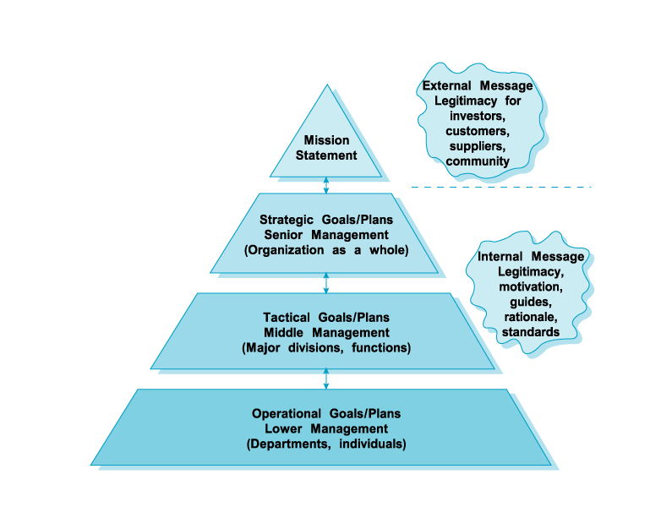
Notes:
This figure illustrates the levels of goals and plans in an organization: The planning process starts with a formal mission statement, that defines the basic purpose of the organization, especially for external audiences.
The mission is the basis for the strategic (company) level of goals and plans, which in turn shapes the tactical (divisional) level and the operational (departmental) level. Planning at each levels supports the other levels.
Proper planning sends FIVE important messages to internal and external audiences –
Legitimacy- What Organization stands for and reason for existence.
Source of Motivation and commitment- Reduces uncertainity and clarifies action
Guides to action- Focus on targets and direct employee efforts
Rationale for decisions- actions & decisions consistent with plans
Standard of performance- Goals define outcome and serve as performance criteria

Slide 7
Organizational Mission
The Mission states the organization’s values, aspirations, and reason for existence.
The Mission Statement is the basis for all following goals and plans.
Without a clear mission, goals and plans may be developed haphazardly causing the organization to fail.
Notes:
Whereas a goal provides the “why” of an organizations existence, a plan tells the “how”. In other words the plan is the route or map to use to get from where you are now (point A) to where you want to be at the goal point in the future (point B)
Goals and plans provide a sense of direction. They help employees focus attention on specific targets.
Mission statements are the basis for the development of all goals and plans. They focus on (1) Market and customers; (2) Desired types of activities; (3) Corporate values; (4) Product quality; (5) Location of facilities; (6) Attitude toward employees;
EXAMPLE- McDonalds- no raises in first year?
Texas Instruments- HARM (High Altitude Radiation Missile) → Electronic Games.

Slide 8
Goals and Plans
Goals: specify future ends. Desired future state.
Plans: specify the means to future ends. “The blueprint for goal achievement… specifies the necessary resource allocations, schedules, tasks…”

Slide 9
Strategic Goals and Plans
Strategic Goals pertain to the entire organization (not specific divisions and departments).
Strategic Plans define the action steps the company will use to attain strategic goals.
Notes:
What kind of TIMEFRAME?
In industry 3-5 years
What about the U.S. Military- Somewhat related to the budget process. POM is five years out

Slide 10

STRATEGIC GOALS AND PLANS

Slide 11

Tactical Goals and Plans
Tactical Goals apply to middle management and describe what major subunits must do to to enable the organization to meet its strategic goals.
Tactical Plans:
  Help execute major Strategic Plans.
  Cover a shorter period of time.
Notes:
Rule of thumb timeframe is shorter, 2-3 years

Slide 12

TACTICAL GOALS
Notes:
Here we have Gen Meyers, Chairman of the Joint Chiefs

Slide 13
Operational Goals and Plans
Operational Goals: the specific results expected of small units, workgroups, and individuals.
Operational Plans: developed at the lower levels of an organization to specify actions required to achieve operational goals and to support tactical plans.
Notes:
Operational goals are the third level- specific results expected from departments, work groups and individuals. Operational plans are developed at the lowest level to support Tactical plans.
KISS
Military Policy
Bad Examples Viet Nam- Johnson “They can’t bomb an outhouse without my say-so.”
Lebanon strikes in the 80’s- Strike plan produced in Pentagon, delivered to the Battle Group onboard USS Independence/ Saratoga. Strike Lead CAG Andrews was not allowed to revise or adjust plan to suit local operational requirements/ changes. Time line based on prime time speechs not on day/night visibility periods for primarily day VFR bombing aircraft (A-7) vice A-6. Strike lead had to make two passes, was shot down on the second pass.

Slide 14


Slide 15
Goal Characteristics
Be specific and measurable
  Quantitive Terms
Cover key result areas
  Contribute most to company performance
Be challenging but realistic
Be for a defined time period.
Be linked to rewards.
Notes:
Criteria for effective goals at all levels-
Specific and Measurable (when possible measure goals in quantative terms, vague goals do not motivate workers)
Cover key result areas- contribute the most to company performance- achieving key result areas please both internal and external customers. Our text stated (pg 108) that most companies measure no more than 20 key result areas in four distinct categories: 1) Financial; 2) Customer Relations; 3) Process-related indicators; 4) Future-value indicators

Slide 16
Types of Plans
Single-use plans are developed to achieve objectives that are not likely to be repeated in the future. Single-use plans include programs, budgets and projects.
Standing plans are used to provide guidance for tasks performed repeatedly within the organization. The primary standing plans are organizational policies, rules, and procedures

Slide 17
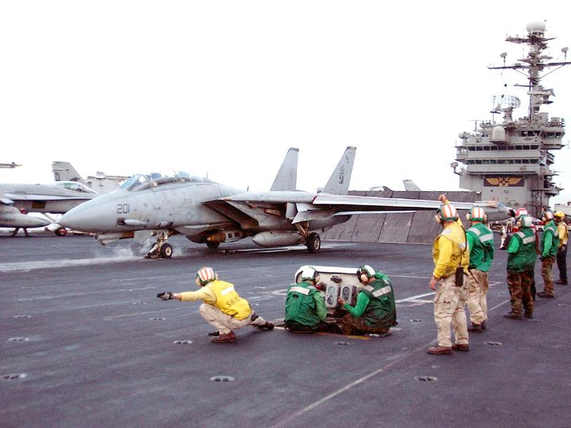
SINGLE-USE
Notes:
This is a catapult shot of an interceptor- It’s an example of a single use plan. Resulting from the planning that occurred in the earlier slide.

Slide 18
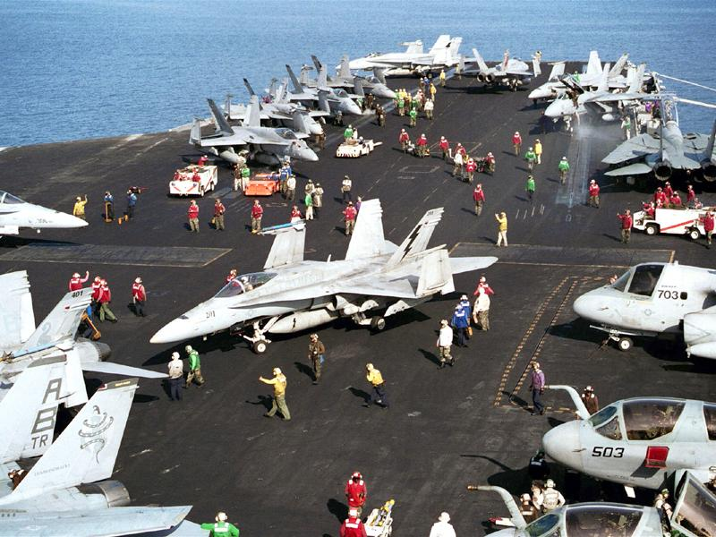
STANDING PLAN
Notes:
In the Navy we see many examples of highly refined and formalized Standing Plans. Here the Air Department, V-1 Division spots aircraft on the flight deck for the next launch and recovery. The procedures they use for aircraft movement are all from standing plans.

Slide 19
Other Types Of Plans
Long term & Short term
Formal & Informal Plans
Proactive & Reactive Plans
Strategic & Operational Plans

Slide 20
The Planning Process
Planning may be seen as the identification and formulation of the objectives of a business (Goal Setting)
Determining Planning Premises
Analyzing the data (Identifying Alternatives)
Evaluation & Selection
Implementation & Review

Slide 21
The Planning Process
GOAL SETTING
Identification and formulation of
objectives
DEVELOPING PLANS
Choices between alternative plans
Reactive Planning
Revision of goals and plans
IMPLEMENTATION
Execution of the plan

Slide 22
Successful Planning Process
Everyone participates
Board and staff educated about planning
Board and staff explore new ideas
Board takes advantages of opportunities
Necessary resources available

Slide 23
Making Planning Effective
Linked to Long term objectives
Consistency
Everyone participates
Feasible
Flexible
Simple
Top Management Support

Slide 24

MANAGEMENT BY OBJECTIVES
Notes:
Definition, next slide

Slide 25
What Is an Objective?
“objective are goals, aims or purposes that organisation wish over varying periods of time”

Slide 26

Management By Objectives (MBO)
A method whereby managers and employees define objectives for every department, project, and person and use them to monitor subsequent performance.

Slide 27
THE NATURE & PURPOSE OF MBO
MBO is concerned with goal setting and planning for individual managers and their units.
The essence of MBO is a process of joint goal setting between a supervisor and a subordinate.
Managers work with their subordinates to establish performance goals that are consistent with higher organizational objectives.
MBO helps clarify the hierarchy of objectives as a series of well-defined means-ends chains.

Slide 28
Essential Steps for MBO
Set Goals
  The most difficult step.
Develop Action Plan
  For both workgroups and individuals.
Review Progress/ Take corrective action
  Periodic during the year.
Appraise Overall Performance.
  Review Annual Goals.
Notes:
These four major activities must occur for MBO to be successful.
MBO seems to me like it would work well for a goal oriented organization.

Slide 29
Essential Steps for MBO
Set Goals
  The most difficult step.
  Concrete
  Specific target and timeframe
  Assign responsibility
Develop Action Plan
  Course of action
  For both workgroups and individuals
Review Progress
  Periodicity?
  Course corrections
Appraise Overall Performance.
  How are we doing?
  Do we need to restate our goals?

Slide 30
MAKING MBO PROCESS EFFECTIVE
If MBO is to be successful, it must start at the top of the organization
Employees must be educated about what MBO is and what their role in it will be.
Managers must implement MBO in a way that is consistent with overall organizational goals.

Slide 31
  Managers tell their subordinates what organizational and unit goals and plans top management has established.
  Managers meet with their subordinates on a one-to-one basis to arrive at a set of goals for each subordinate that both develop and to which both are committed.
  Goals are refined to be as verifiable as possible and achievable within a specified period of time.

Slide 32
  Goals must be written and very clearly stated.
  Managers must play the role of counselors in the goal-setting and planning meeting.
  The meeting should specify the resources that he subordinate will need
  Conducting periodic reviews
  The employee is rewarded on goal attainment.

Slide 33
THE EFFECTIVENESS OF MBO - STRENGTHS
Organizations create a powerful motivational system for their employees by adopting MBO.
Through the process of discussion and collaboration, communication is greatly enhanced.
With MBO performance appraisal may be done more objectively.

Slide 34
THE EFFECTIVENESS OF MBO - STRENGTHS
MBO helps identify superior managerial talent for future promotion.
MBO provides a systematic management philosophy
MBO facilitates control through the periodic development and subsequent evaluation of individual goals and plans.

Slide 35
THE EFFECTIVENESS OF MBO - WEAKNESSES
The major reason for MBO failure is lack of top management support
goals and plans cascading throughout the organization may not be those of top management.
Some firms may overemphasize quantitative goals
Some managers will not or cannot sit down and work out goals with their subordinates

